Slide 1





PROMISE@LAB
PROMISE@LAB
JOINT RESEARCH LAB: PROTOCOLS AND
OUTCOME MEASURES IN REHABILITATION MEDICINE
PROMISE@LAB
Scientific Director:
prof. FRANCESCA CECCHI,
AP, MD

Slide 2






Joint Research Lab
University of Florence - Department of Experimental and Clinical Medicine (DMSC)
Multidisciplinary Research and Innovation at DMSC
• Joint research environment; multiple scientific disciplines
• Focus on high-quality clinical and experimental research
• Strong commitment to scientific and technological innovation
• Advanced academic and professional training for students
UniFI Departments affiliated to PROMISE@LAB
Health sciences (DSS)
Neurosciences-Pharmacological-Pediatric (NEUROFARBA)
Industrial Engineering (DIEF)

Slide 3

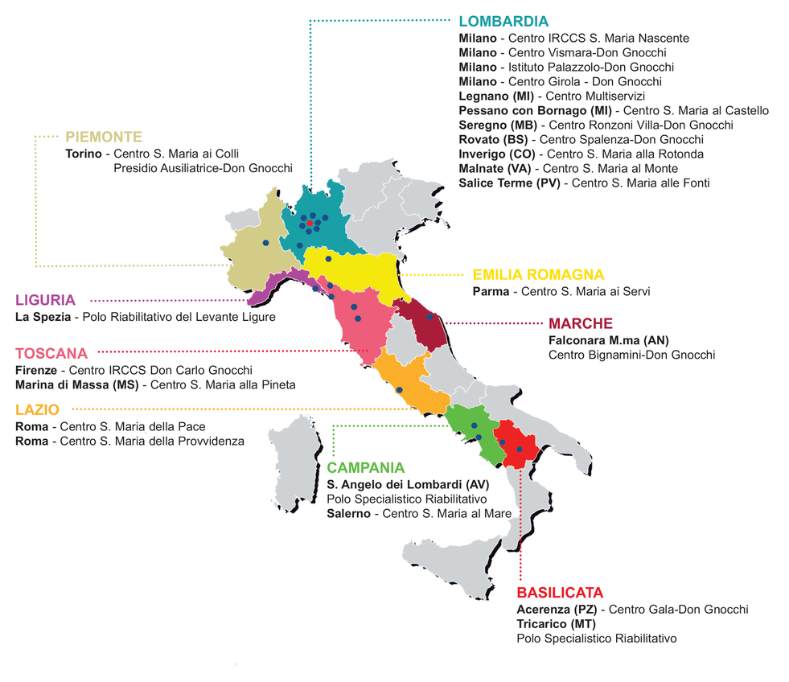
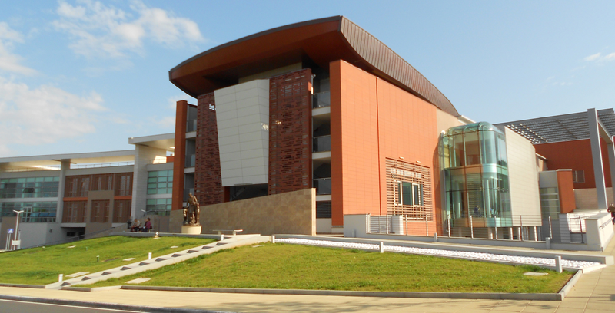
Joint Research Lab
IRCCS Fondazione don Carlo Gnocchi, Florence
National Excellence in Rehabilitation
• 3rd sector Care and Rehab Institution: 27 Centres across Italy
• Scientific Institute for Care and Research
(IRCCS - Milan and Florence)
• Complex Neuromotor Rehab
University-directed Structure
UniFI-FDG IRCCS Florence:
capacity: 100 beds + 100
outpatients/day
• Strong clinical environment
supporting translational research

Slide 4

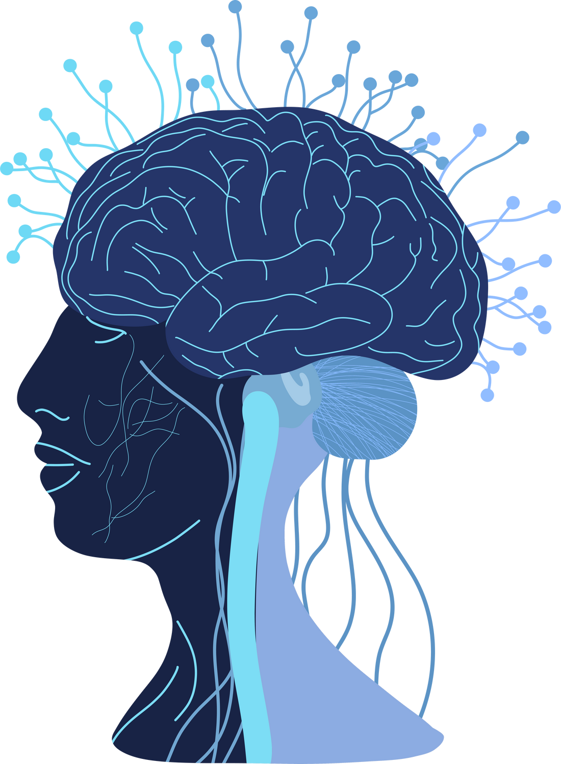



PROMISE@lab
Mission and Expertise
INTERDISCIPLINARY RESEARCH GROUP
DEVELOPMENT AND VALIDATION
Physiatrists, geriatricians, neurologists, Physical Therapists, Speech Therapists, Occupational Therapists.
Psychologists
Outcome measures, Rehabilitation interventions, Rehabilitation technologies
FOCUS
INNOVATION
Neuromotor disability
Neurological rehab (Stroke, PD, sABI)
Healthy and Active Aging
Co-creation with stakeholders
Patient and Public Involvement
Use of AI tools

Slide 5










PROMISE@lab
Main activities
Multicentric observational studies
Co-creation
Randomized Controlled Trials
Clinical measures validation
Medical devices testing
Usability and feasibility
Single subject design
Cross cultural adaptation
Robot- and sensor-derived measures validation
Case series

Slide 6
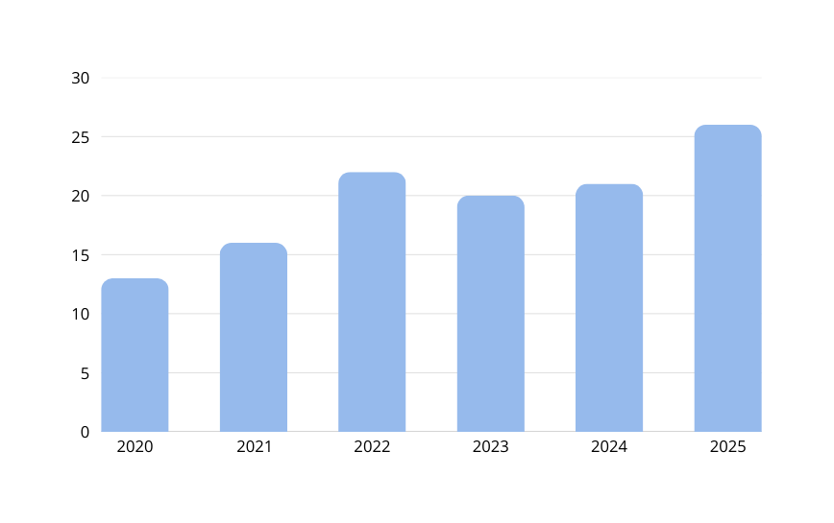
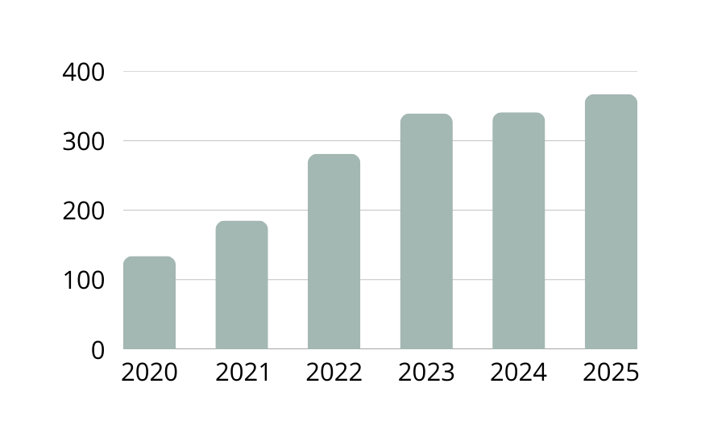
PROMISE@lab
Research focus
Innovating and improving rehabilitation assessment and treatment protocols
Comparing treatment effectiveness
Supporting technological development through co-creation with stakeholders
Medical devices testing
Exposures affecting patients’ outcomes
Co-developing outcome prediction models
PUBLICATIONS
CITATIONS

Slide 7
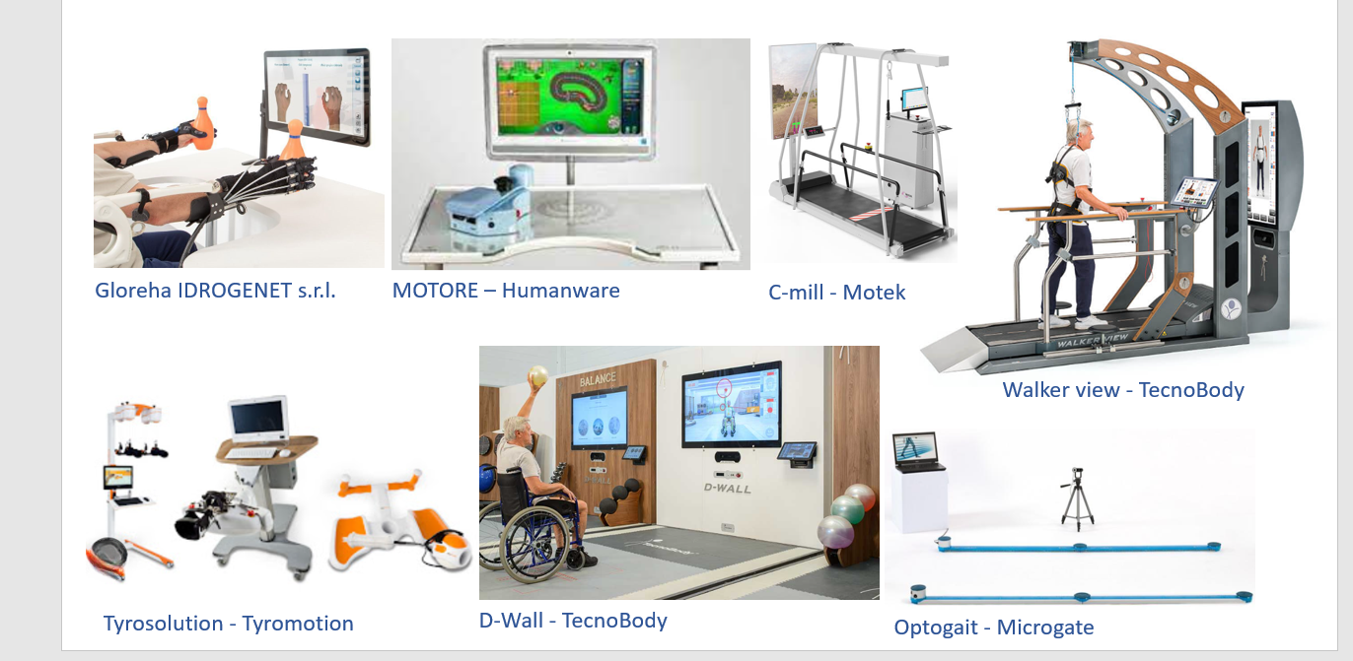
PROMISE@lab
End-to-End technologies for rehabilitation

Slide 8
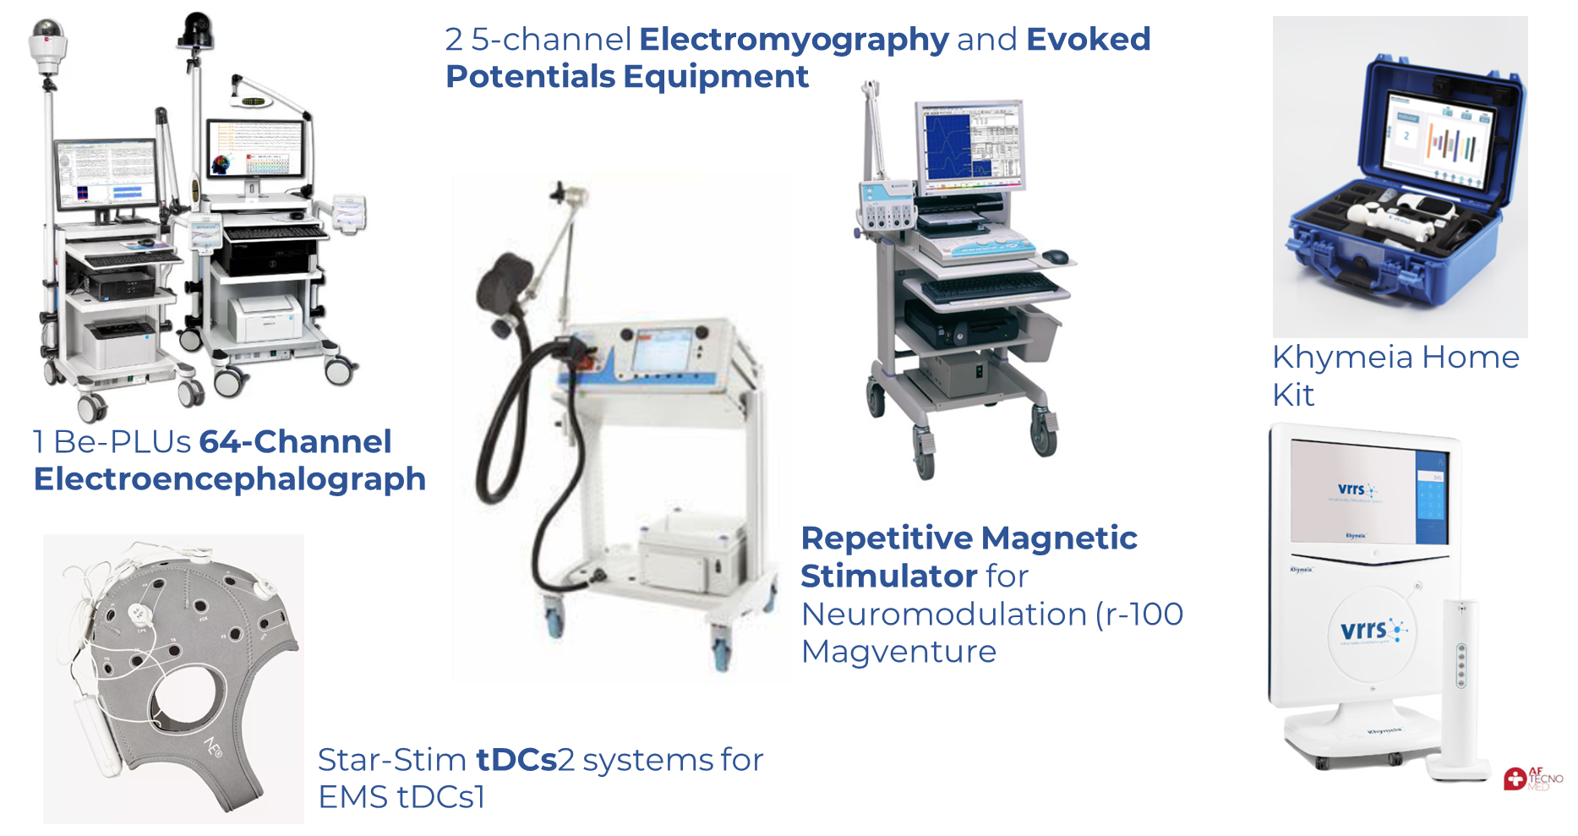
PROMISE@lab
Virtual Reality, Neurophysiology, Neuromodulation - IRCCS FDG Florence Facility

Slide 9
PROMISE@lab
ONGOING RESEARCH
ACTIVE AGEING
Age-IT - A novel public-private alliance to GEnerate socioeconomic, biomedical and technological solutions for an inclusive ITalian ageing society
INFORMA - pIattaforma iNnovativa Funzionale e adattiva per prOmuoveRe un invecchiaMento sAno e attivo
STROKE
STRATEGY - Design and national implementation of a registry of post-stroke rehabilitation patients for systematic evaluation of processes and outcomes and development of data-driven prediction models
BIG-MENTI – National Database of the Virtual Institute of CErebrovascular Diseases - a multicentric observational study (PI P. Calabresi, IRCCS Gemelli Rome)
PESO - Parametrare Esiti Stroke Ospedalieri - Outcomes of patients with acute cerebrovascular event - a prospective longitudinal observational study
(PI P. Palumbo, USLToscana Centro)
REDIRECT - A RandomizED controlled trial on the effects Induced by Robot-assistED rehabIlitation versus occupational therapy on the functional recovery of the upper limb in chronic post-strokE subjeCTs
SCORES – Sensory and Cognitive Outcomes of Robotic Exercises in Stroke - a multicentric RCT (PI M. Germanotta, FdG Rome)
BE-TOP - Biomarcatori Elettroencefalografici per l’ottimazione e personalizzazione della Terapia di Osservazione dell’azione in Pazienti con esiti di ictus in fase cronica- New strategies to maximize the effectiveness of functional rehabilitation of the upper limb - a multicentric clinical trial (PI F. Infarinato,
IRCCS San Raffaele Rome)

Slide 10
PROMISE@lab
ONGOING RESEARCH
NEURODEGENERATIVE DISEASES
SANDY-POC - An Innovative method in SAliva samples for the early differential diagnosis of high-impact NeuroDegenerative diseases through Raman
spectroscopY - a multicentric prospective observational study
MINERVA - Nuovo metodo per la diagnosi delle malattie neurodegenerative basato sulla profilazione biochimica della saliva - a multicentric prospective observational study (PI P. Arcuri, FdG Milan)
INERTIAL - DefINizionE di ReliabiliTy e valIdity delle misure derivate da sensore in persone con mALattia di Parkinson - Clinical investigation with a pre-market medical device.
REHABILITATION TECHNOLOGIES
THE - Tuscany Health Ecosystem; SPOKE 3: Advanced technologies, methods and materials for human health and well-being (spoke leader UNIFI;
partner affiliati UNIPI, UNISI, CNR, SSSA, IMT, Esaote, Museo Galileo), PNRR SPOKE 3

Slide 11
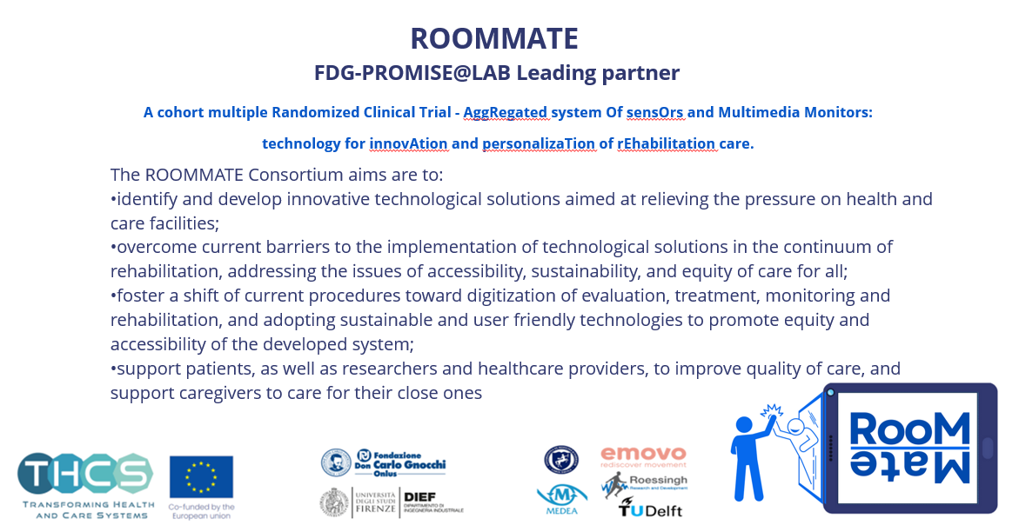
PROMISE@lab
European Projects - PROMISE@LAB Leading Partner: THCS ROOMMATE
ROOMMATE

Slide 12






PROMISE@lab
European Projects - PROMISE@LAB Leading Partner: THCS INTEGRA
INTEGRA
Co-creation of an INnovative TR Ecosystem accessible on a GRAnd scale to persons with disabilities living in the community
The INTEGRA Consortium aims to:
co-create a scalable and adaptable telerehabilitation (TR) ecosystem integrated into primary and community care, tailored to different European healthcare contexts;
improve functioning, participation and quality of life of persons with disabilities living in the community through personalized, home-based TR services;
overcome barriers to TR adoption (regulatory, technological, organizational and socio-cultural), promoting equity, accessibility and digital inclusion;
develop a multidimensional EU knowledge base to benchmark best practices and support evidence-based redesign of TR services across Europe;
support patients, caregivers and healthcare professionals through co-creation, e-health coaching and sustainable service models, strengthening continuity of care.

Slide 13


PROMISE@lab
European Projects - PROMISE@LAB Leading Partner: EP PerMed Education Call 2025
PRISMA
Personalised Rehabilitation: the InterdiSciplinary Management of non-specific Low Back Pain
The PRISM project aims to:
develop a scalable and reusable asynchronous training programme to support the implementation of Personalised Interdisciplinary Rehabilitation (PIR) for non-specific low back pain across European healthcare and educational contexts;
enhance healthcare professionals’ competences in multidimensional assessment, clinical reasoning, and personalisation of rehabilitation interventions based on best evidence and real clinical cases;
promote interdisciplinary collaboration, shared decision-making, and patient engagement as core components of personalised rehabilitation pathways;
address cultural, educational, and organisational barriers that currently limit the adoption of biopsychosocial and personalised approaches in low back pain management;
contribute to the sustainability of European healthcare systems by improving Personalised Medicine literacy, enabling knowledge translation into clinical practice, and supporting long-term reuse of training contents in academic and professional education.

Slide 14





















PROMISE@lab

Slide 15
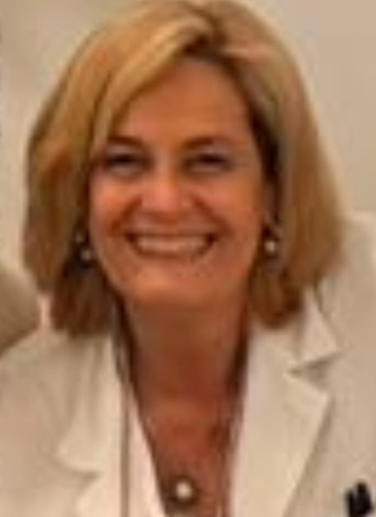
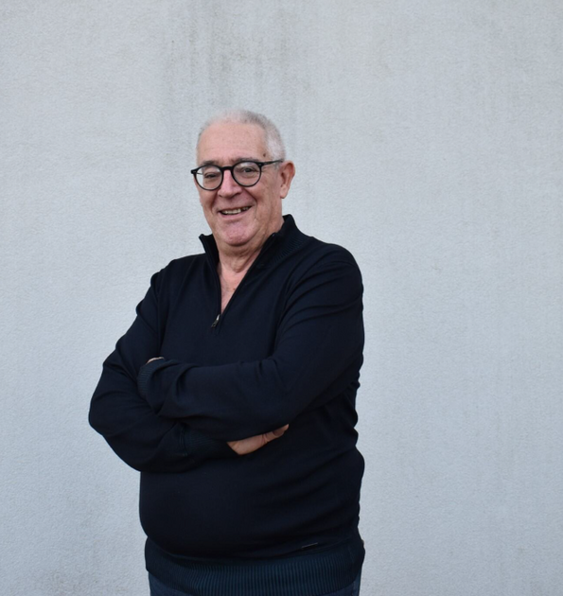
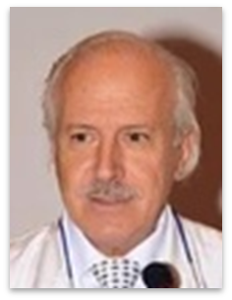
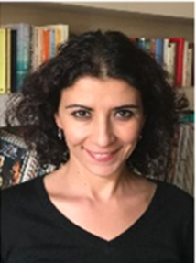
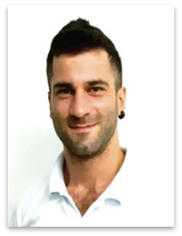
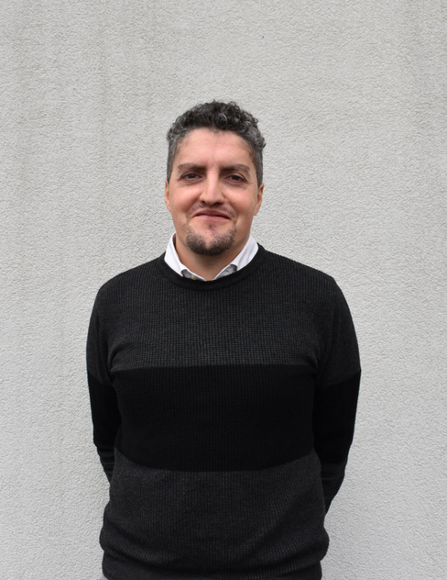
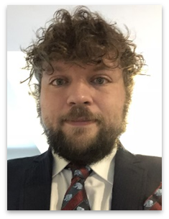
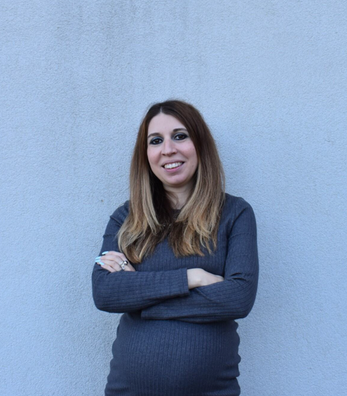
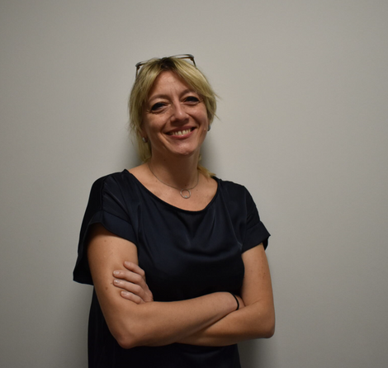
PROMISE@lab
Scientific Board
Group Coordinators
Francesca Cecchi, AP
Scientific Director
Marco Baccini, AdP
Scientfic Co-Director
Claudio Macchi, FP
Bahia Hakiki, AP
Geriatrician, Cardiologist
FDG
publications
MD, PhD, Neurologist, AP
DMSC-FDG
publications
MD, Physiatrist, Geriatrician
DMSC-FDG
publications
PT, MCs DMSC-FDG
publications
LAB Coordinators
Stefano Doronzio
Giulio Cherubini
Diego Longo
PT, Msc, PhD
DMSC-FDG
publications
PT, Msc, PhDs
DMSC
publications
PT, Msc, PhD
DMSC
publications
Stefano G. Doronzio PT, MSc, PhDs: Robotics group coordinator
Giulio Cherubini, PT, MSc, PhDs: Parkinson’s Disease group coordinator
Diego Longo, PT, Msc, PhD: Healthy Aging group coordinator
Donata Bardi
Chiara Castagnoli
Donata Bardi, PSY, MSc; Project Manager
Chiara Castagnoli, PT, MSc: bedside and benchside Research Coordinator
PSY, Msc -FDG
Project Manager
publications
PT, MSc -FDG
Research Group Coordinator
publications

Slide 16


PROMISE@lab
Maria Angela Bagni
FP Physiology; publications
Mario De Marco
PT, MSc; publications
Marta Massei
PSY, MSc
Michele Piazzini
PT, MSc; publications
Virginia Ambrogi
PSY, MSc
Monica Bernabè
PT
Tommaso Ciapetti
PT, MScs; publications
Agnese De Nisco
ST; publications
Maria Luigia Del Vicario
PT, MScs; publications
Julieta Giacani
OT; publications
Sara Marignani
ST; publications
Ilaria Pellegrini
ST, MSc; publications
Chiara Pedrini
PSY, MSc; publications
Angela M. Politi
PT; publications
Olimpia Salvini
PSY, MSc
Alessandro Sodero
MD, Neurologist, PhDs;
publications
TEAM

Slide 17
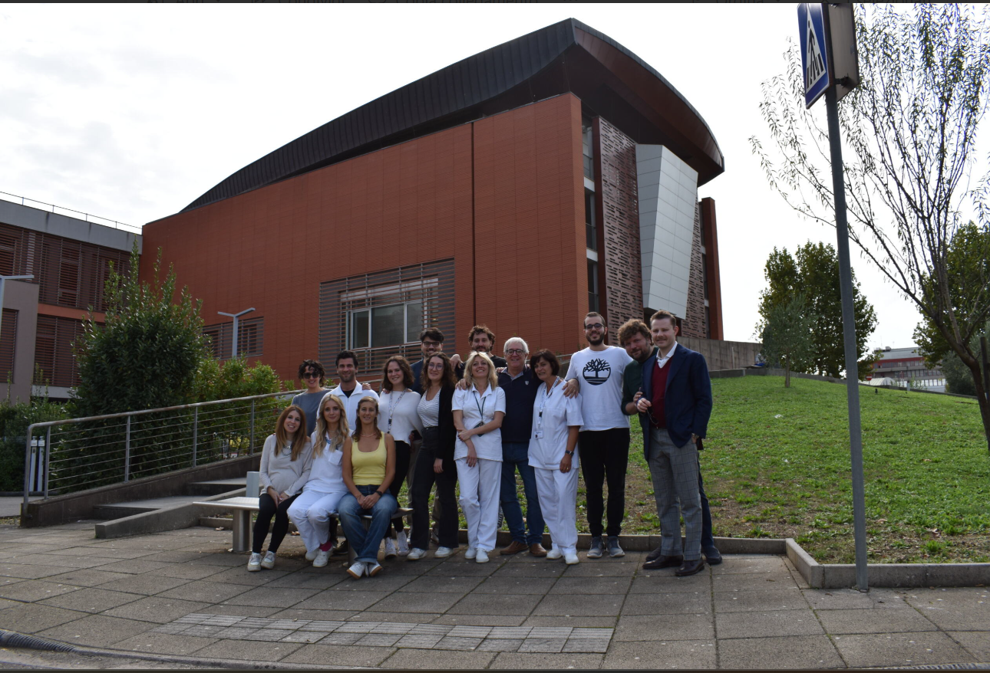


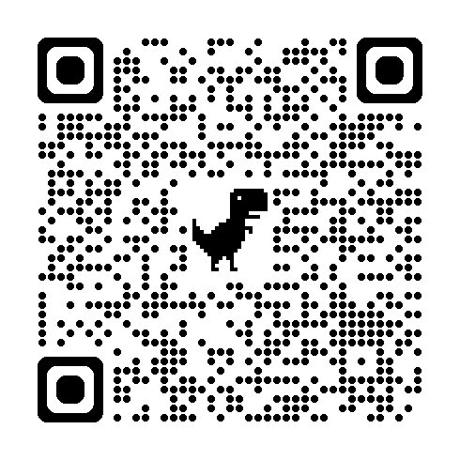
PROMISE@lab
THANK YOU!
Contact us
francesca.cecchi@unifi.it
dbardi@dongnocchi.it

